Slide 1
Legislative Briefing on the Assessment of Delaware Public School Funding by the American Institutes of Research
March 7, 2024

Slide 2
Agenda
Welcome
Review Agenda
Committees’ Roll
Introduce Speakers
  Drew Atchison, Senior Researcher, American Institutes of Research (in person)
    Findings and Recommendations: Assessment of Delaware Public School Funding December 2023
    State Comparisons: performance and level of investment
  Q&A
  b. Bruce Baker, Professor and Chair of the Department of Teaching and Learning, University of Miami (via Zoom)
    Impacts of investments
    Flexibility
  Q&A
  c. Kenneth Shores, Assistant Professor, University of Delaware (in person)
    Impacts in states that invest more in student-based systems
  Q&A
  d. Discussion with panel on next steps for Delaware
5. Next Steps and Closing Comments

Slide 3

Drew Atchison
Senior Researcher
American Institutes of Research

Slide 4
Assessment of Delaware Public School Funding
Recommendations

Slide 5
Independent Assessment of Delaware Public School Funding
Study was a requirement from a 2020 legal settlement between plaintiffs and the state.
July 2022, AIR was hired to conduct a comprehensive assessment of Delaware’s current public education funding system and provide recommendations for improvement.
Our charge, as outlined in the request for proposals:
  Conduct comparative analysis to other states
  Fully research and understand existing funding structure
  Evaluate revenue and spending in a variety of ways to highlight existing disparities
  Present recommendations for future improvements that may result in improved funding equity with a focus on improving outcomes for all students – including recommended funding levels.
education.delaware.gov/community/data/reports/assessment-of-delaware-public-school-funding/

Slide 6
Emphasis of The Study
Adequacy
  Are current funding/spending levels sufficient to meet the state’s educational goals?
  How should funding be distributed across districts and schools to provide equal educational opportunity?
Equity and Wealth Neutrality
  How is existing school funding/spending distributed with respect to student needs (e.g., low-income status, English learner status, disability status)?
  To what extent are school funding levels dependent on local revenue capacity?
Transparency, Flexibility, and Stability
  Are funding mechanisms easy to understand and are funding amounts easily calculable?
  Is funding provided in a way that allows districts and schools flexibility in how to use it?
  Are funding amounts stable over time and predictable, allowing for long-term planning?

Slide 7
Recommendations
Increase investment in Delaware’s public education

Slide 8
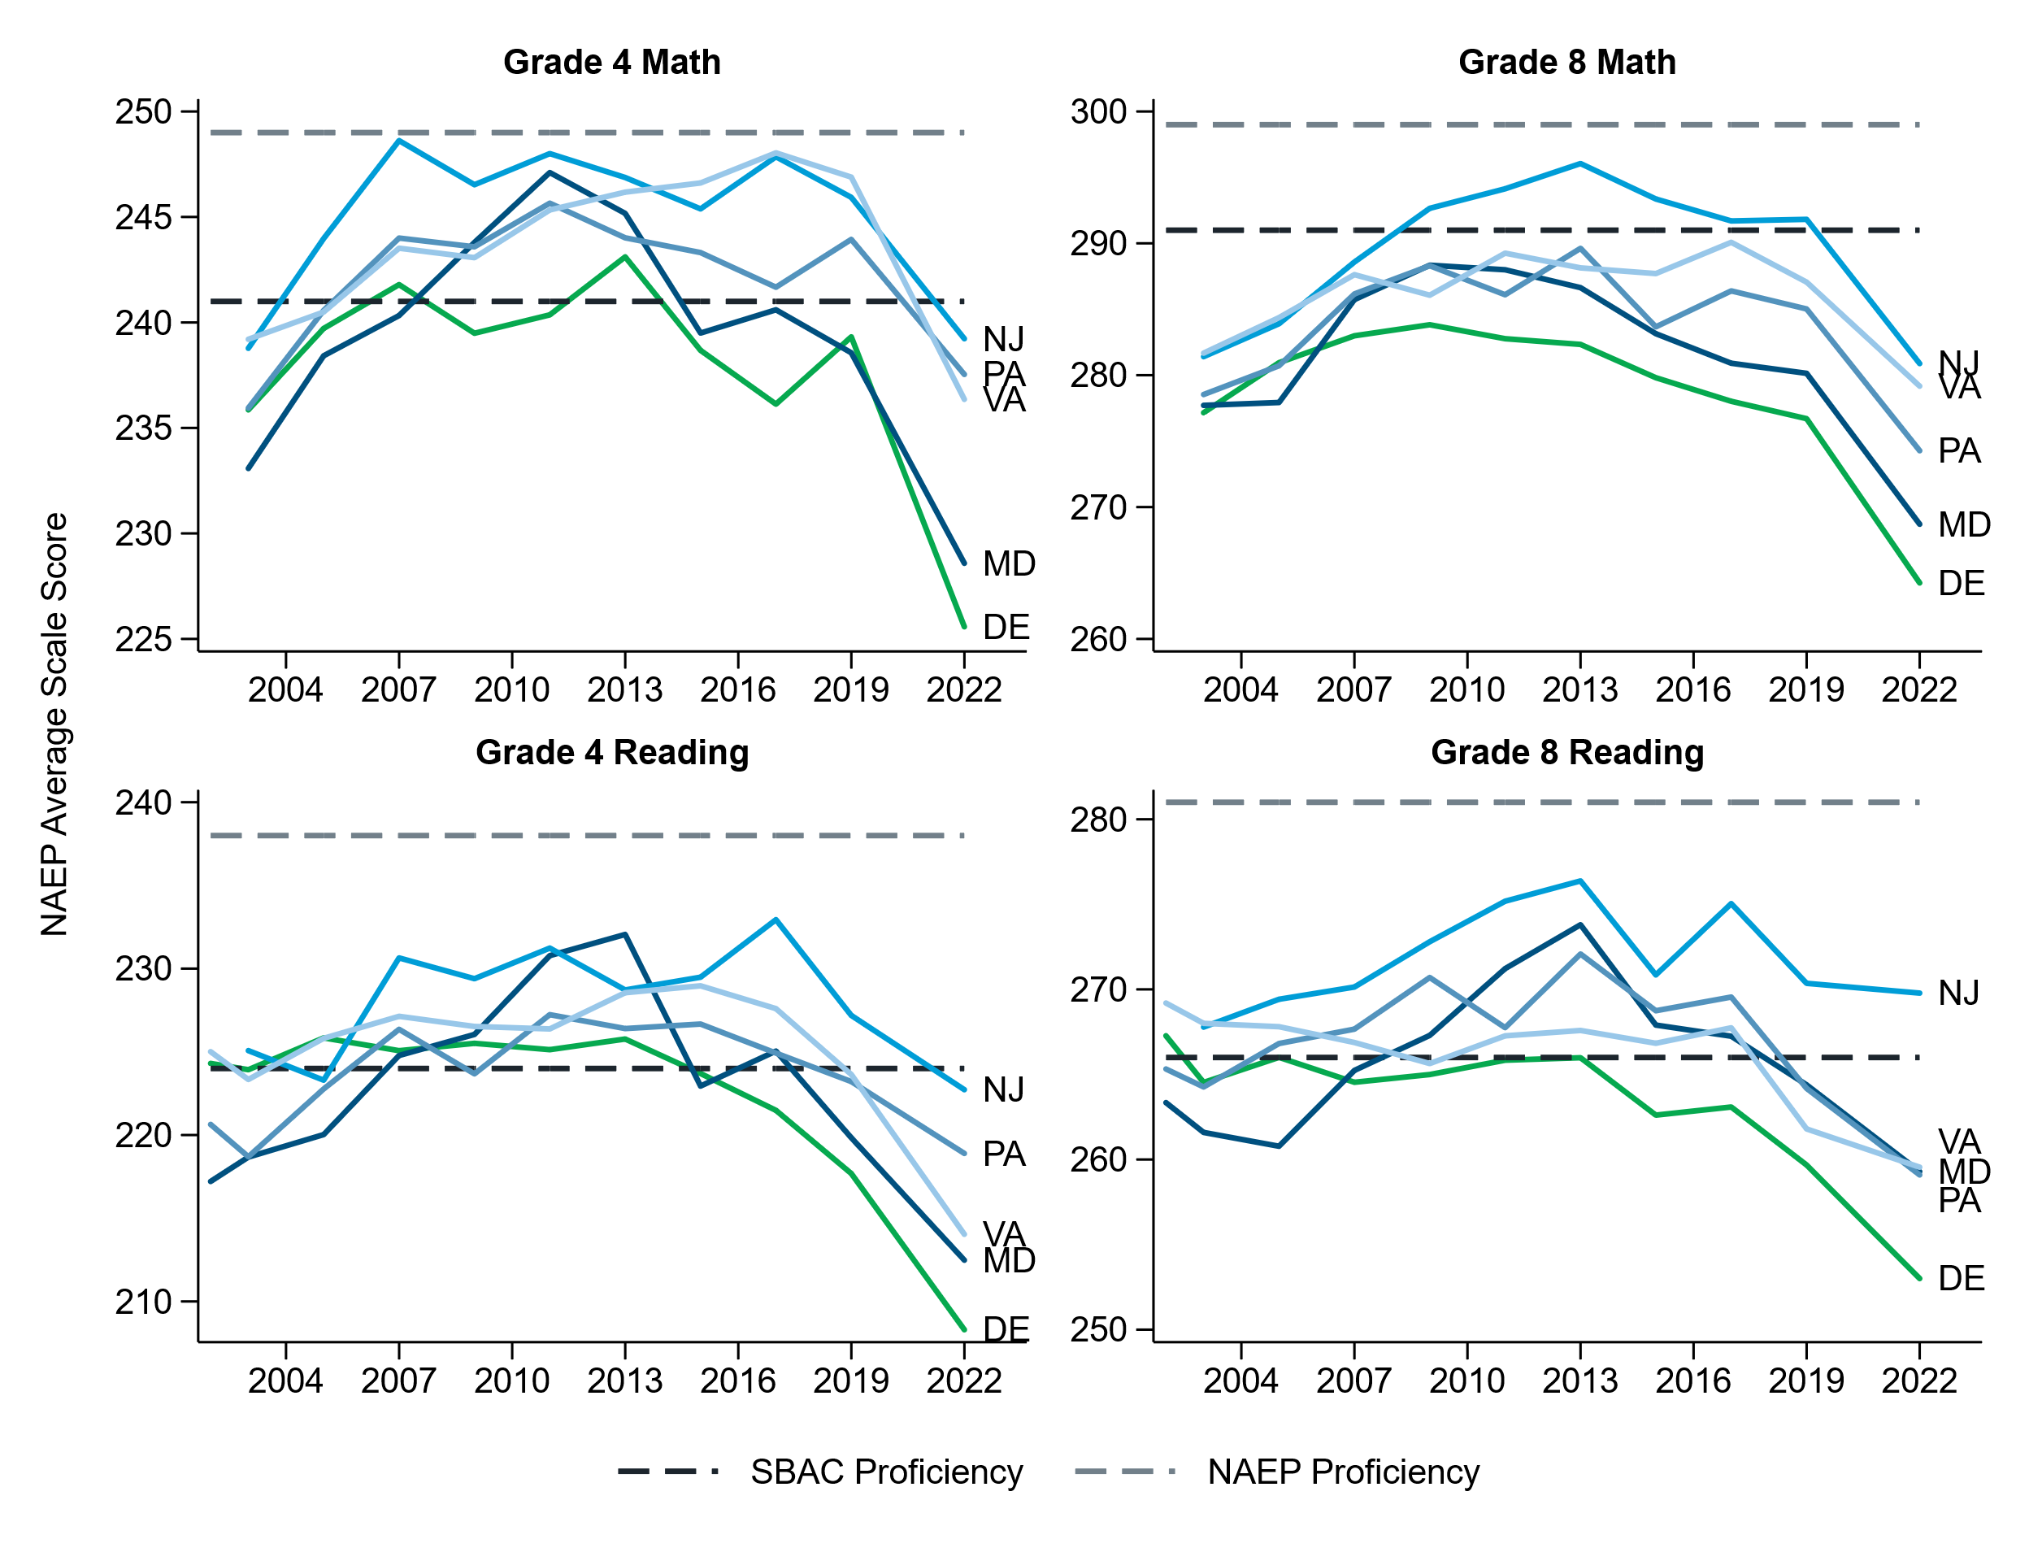
Delaware’s performance on NAEP lags neighboring states and is in decline
Note: Exhibit 9 in main report.

Slide 9
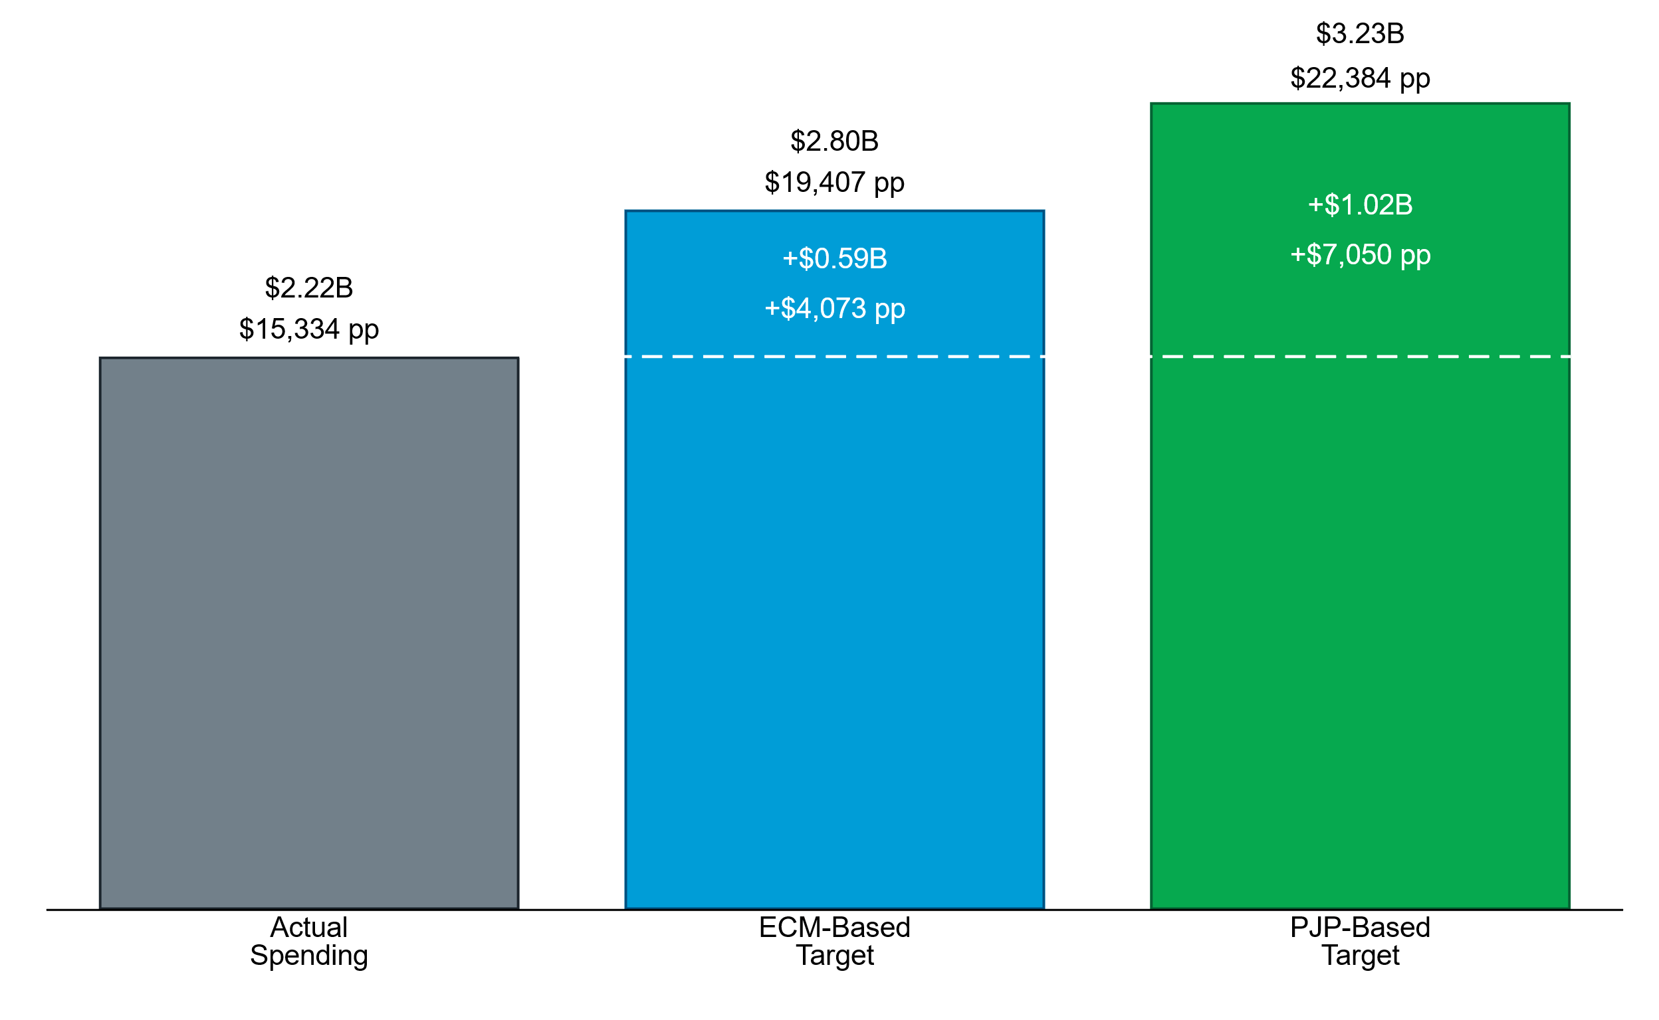
The Education Cost Model and Professional Judgment Panel adequacy analyses suggest a need to spend an additional $590 million (27%) to $1 billion (46%) on public education to meet the state’s educational goals.
+46%
+27%
Note: Data from 2022. Exhibit 67 in main report.

Slide 10
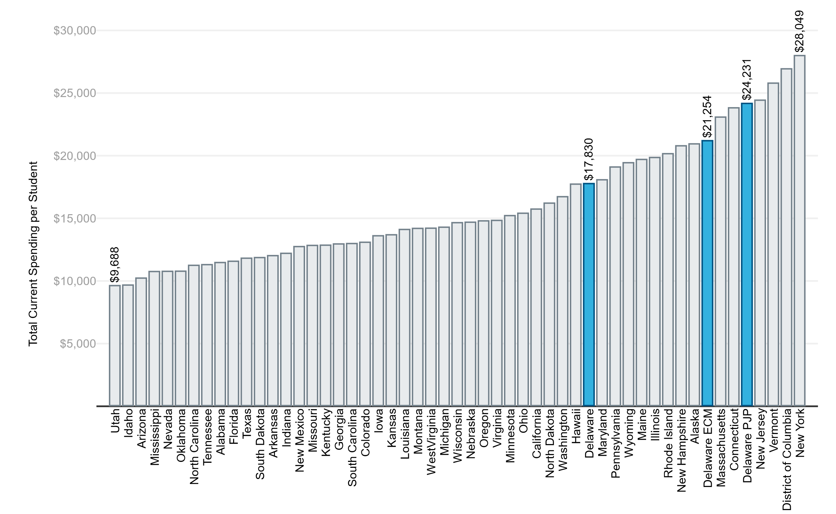
The amounts suggested by the two adequacy analyses are attainable. Several states already spend at rates higher than what was suggested by the analyses.
PJP-Based Target
ECM-Based Target
Actual Spending
Note: Exhibit 78 in main report.

Slide 11
Recommendations
Increase investment in Delaware’s public education
Distribute more resources according to student need

Slide 12
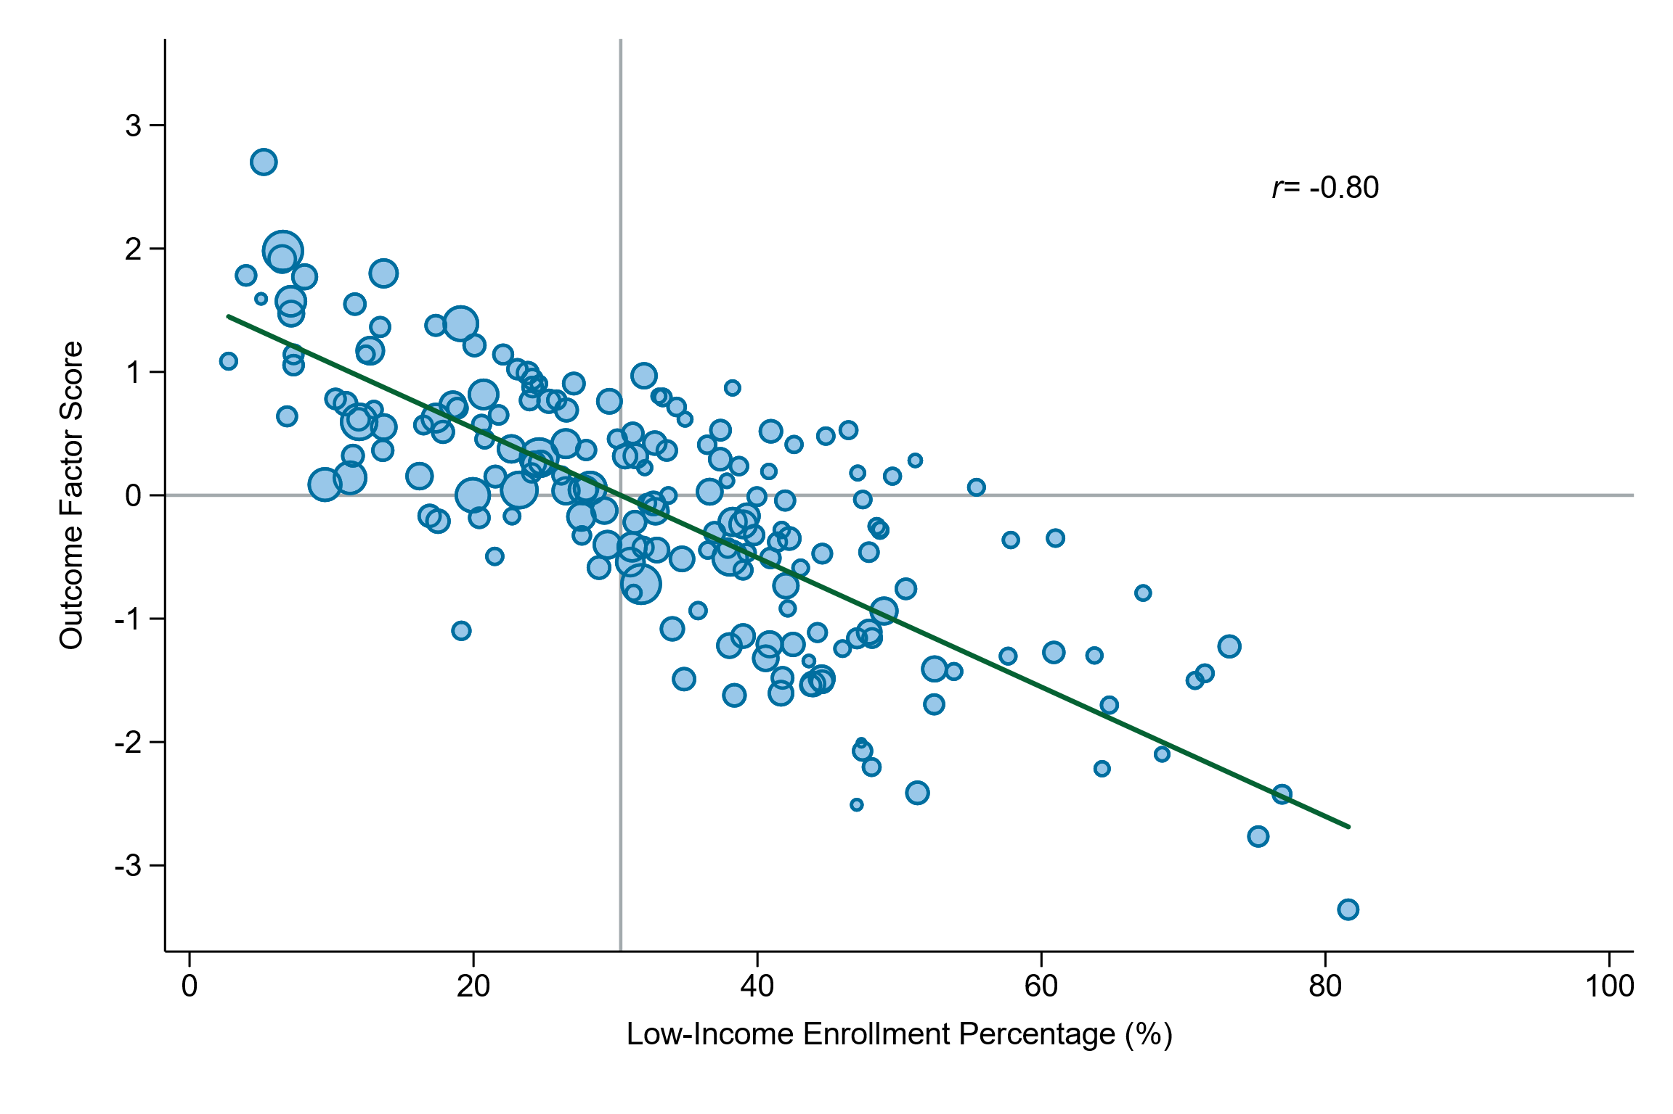
Student outcomes are systematically lower in schools with higher percentages of low-income students
Schools with higher percentages of SWDs and ELs also tend to have lower outcomes.
Note: Data from 2022. Exhibit 9 in main report.

Slide 13
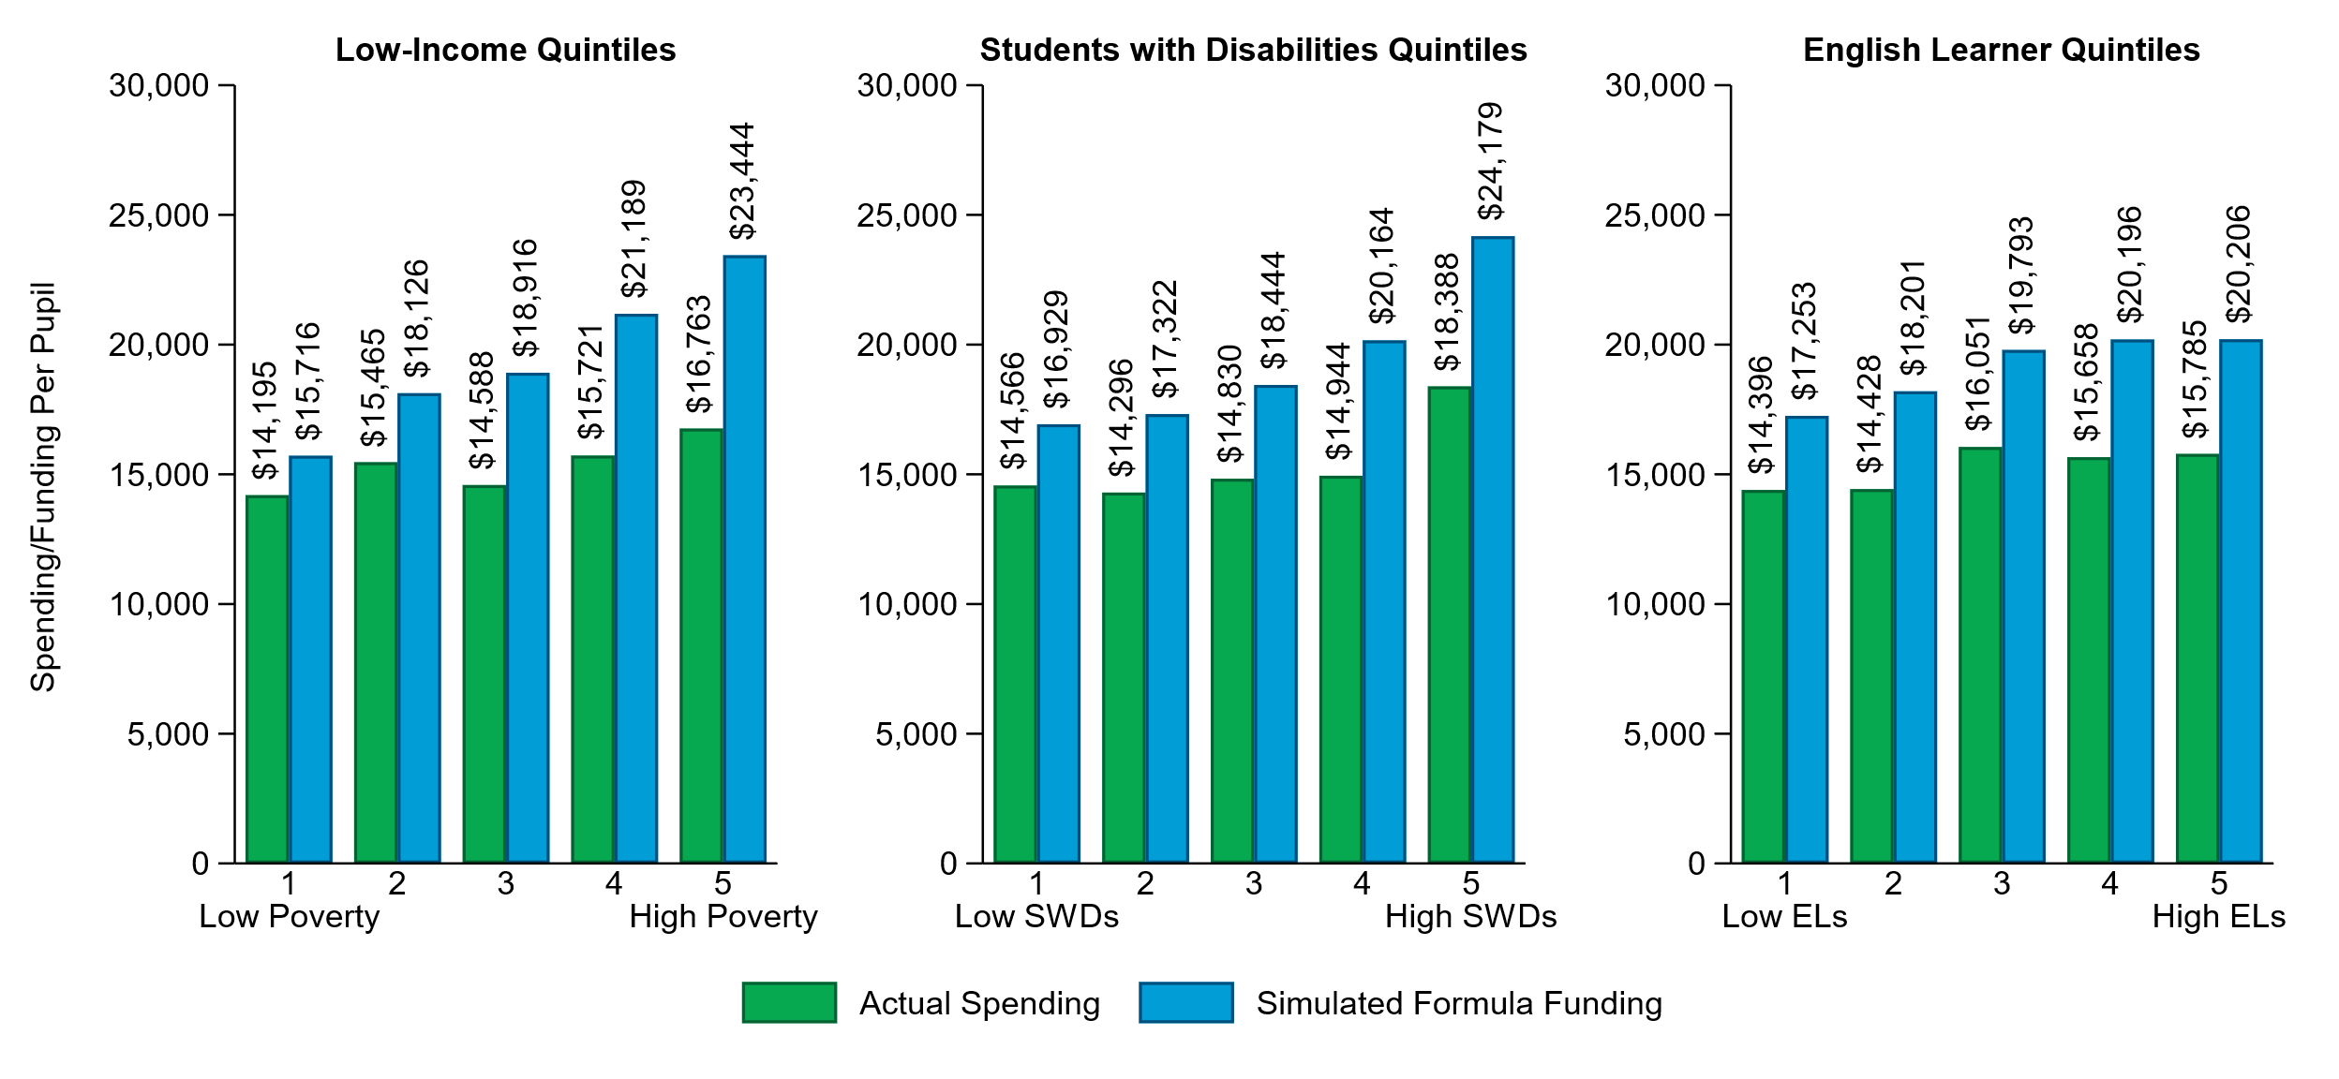
Both the ECM and PJP adequacy analyses suggest a need to distribute funding more strongly based on student need.
Note: Results from ECM analysis. Data from 2022. Exhibit 53 in main report. Exhibit 64 in the main report shows the comparable results for the PJP analysis.
Notes:
Explain columns are within quintile averages.
E.g., Lowest poverty quintile needs an additional ~11% and the highest poverty quintile needs an additional 40%.

Slide 14
Recommendations
The presence of many formulas that allocate different resources and pots of money along with the uncertain translation of a unit into a funding amount creates a system in which understanding the sum of resources and funding that flow to schools and districts difficult, if not impossible, for most.
Increased transparency will bring more people to the table and allow for families, community members, and other stakeholders to be more effective advocates.
Increase investment in Delaware’s public education
Distribute more resources according to student need
Improve funding transparency

Slide 15
Recommendations
In most state funding systems, dollars are allocated to districts largely as general funding, which districts can then decide how to use.
Delaware’s unit system allocates positions with the expectation that positions are used how they are allocated.
Delaware administrators noted that requirements to use dollars in certain ways added burden and reduced efficiency.
Flexibility, in theory, should result in more effective use of resources that better meet the varied needs of students across schools and districts.
Increase investment in Delaware’s public education
Distribute more resources according to student need
Improve funding transparency
Allow for more flexibility in how districts use resources
Notes:
Consider what fiscal accountability might look like.

Slide 16
Recommendations
In large part, Delaware’s state funding system allocates state resources in a way that is independent of the ability of districts to raise revenue locally.
Equalization funding is outdated and insufficient.
Most states account for local capacity through a varying local share, where an overall spending/funding target is set, and then districts with higher local capacity are expected to fund a higher percentage of the overall target (more on this to follow).
Increase investment in Delaware’s public education
Distribute more resources according to student need
Improve funding transparency
Allow for more flexibility in how districts use resources
Account for local capacity and address tax inequity

Slide 17
Equalization funding has not been updated for over a decade and was described by district administrators as “broken,” “flawed,” and “outdated.”
We're not able to pay our teachers as hefty a salary as other districts who have a better source [of local revenue]. The real estate property values are much higher, they have more property in their district that they can tax. So, we're at a disadvantage. We're also in an economically depressed area, in addition to that. You mentioned the equalization formula; that's been frozen since 2009. It's outdated; it's not functioning correctly. So that's where, when you want to talk about equity and funding, I mean, that's the heart of it right there—there is no equity in the funding anymore.
– District administrator

Slide 18
Recommendations
Because assessed property values are outdated and perceived to be inaccurate, they undermine trust in any approach attempting to address differences in local capacity.
The fact that assessed property does not increase over time also strains the ability of local revenue to keep up with increased costs. This means that tax rates must continually increase – exacerbating issues related to the referendum requirement.
Increase investment in Delaware’s public education
Distribute more resources according to student need
Improve funding transparency
Allow for more flexibility in how districts use resources
Account for local capacity and address tax inequity
Regularly reassess property values
PROGRESS UNDERWAY

Slide 19
Recommendations
Charter school leaders perceive the current system of calculating the local share to lack transparency and be excessively variable from year-to-year and across districts.
A formula based on local revenue would be simpler and more consistent from year-to-year.
Increase investment in Delaware’s public education
Distribute more resources according to student need
Improve funding transparency
Allow for more flexibility in how districts use resources
Account for local capacity and address tax inequity
Regularly reassess property values
Simplify the calculation of local share provided to charter schools

Slide 20
Recommendations
Increase investment in Delaware’s public education
Distribute more resources according to student need
Improve funding transparency
Allow for more flexibility in how districts use resources
Account for local capacity and address tax inequity
Regularly reassess property values
Simplify the calculation of local share provided to charter schools
Implement a weighted student funding (or foundation) state funding formula

Slide 21
Weighted Student (Foundation) Formula – Approach Used in Many Other States
Target funding amount determined using weights to account for differences in student needs and context
State share determined based on the amount needed to achieve the target funding amount after accounting for the local share
Local share determined based on the amount of revenue able to be raised locally based on a reasonable uniform property tax rate.

Slide 22
Recommendations
Our recommendations would most easily be implemented through a foundation formula that uses student weights to distribute dollars to districts:
Dollars can be easily distributed according to student need
Funding is distributed transparently through easy calculations
Funds can be used flexibly
Differences in local capacity can be easily incorporated
The formula can be applied consistently to both districts and charter schools
Increase investment in Delaware’s public education
Distribute more resources according to student need
Improve funding transparency
Allow for more flexibility in how districts use resources
Account for local capacity and address tax inequity
Regularly reassess property values
Simplify the calculation of local share provided to charter schools
Implement a weighted student funding (or foundation) state funding formula

Slide 23
Q&A

Slide 24

Bruce Baker
Professor and Chair of the Department of Teaching and Learning
University of Miami

Slide 25
Outline
How & Why Money Matters for Schools
What we Know from Recent Research
Thoughts on Policy Design & Implementation

Slide 26
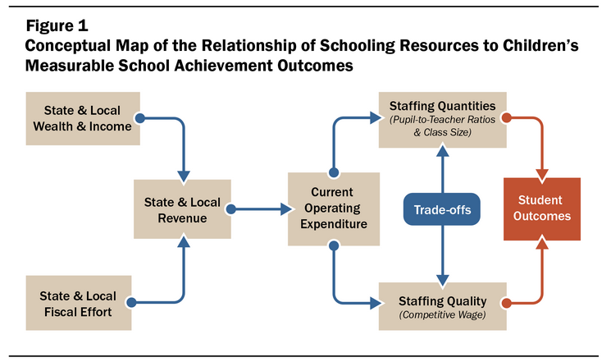
https://learningpolicyinstitute.org/product/how-money-matters-brief

Slide 27
Production Analysis
Staffing Wages
Current Operations
Program Organization & Delivery
Staffing Quantities
Student Engagement
Student Attendance
Spending*
MS&E &Other
Labor Market / Workforce Effects
Long Term outcomes
Student Academic Achievement
Facilities Improvements
Capital Investment
Quality of Indoor & Outdoor Spaces
Student Health
New Facilities
Cost Analysis

Slide 28
Evolving Research on “Money Matters”
Conclusive evidence over the last 20 years: investing more, particularly in targeted populations, leads to gains in academic attainment
1971
1989
1992
2007
2019
School Funding Context
Wealth Equalization
r*
Targeted Increases
(Progressiveness)
Great Recession
J&M, 2023
JR&DS, 2022
ER&YS, 2022
J&W, 2021
JWX, 2021
1966
Coleman
Hanushek, 1986
Card & Payne, 2002
JJP, 2014&15
Meta-Wars
EAH v. HLG
Regression-based
Production Functions
National
JL, JR &DS, 2018
C&S, 2019
Research & Eval
State (or Policy) Specific
Guryan, 2001
Mass (’93)
Deke, 2003
KS (’92)
Hyman, 2017
Mich (’95)
Barron, 2022 (WI)
Abbott, 2020 (7)
Rauscher, 2020 (KS)
Kreisman, 2019 (TX)
Gigliotti, 2018 (NY)
Johnson, 2018 (CA)
Downes, 2004
VT (’98)
Roy, 2011
Mich (’95)
*Cost Modeling, 1994 →
Chaudhary, 2009
Mich (’95)

Slide 29
2023 Meta-Analysis of Causal Impacts
Jackson, C. K., & Mackevicius, C. L. (2023). What impacts can we expect from school spending policy? Evidence from evaluations in the US. American Economic Journal: Applied Economics.
  Identified 31 studies that met specific conditions as of December 1, 2020.
    Of 32 unique study-outcomes, 25 present estimates of test score impacts (either test scores or proficiency rates) and 12 present estimates of impacts on educational attainment (high school dropout, high school graduation, or college enrollment). The studies represent a range of estimation strategies and sources of variation.
  To facilitate direct comparison, for each study we constructed an estimate of the marginal policy-induced impact on standardized outcomes of exposure to a $1000 per-pupil spending increase (in 2018 dollars) over four years.
    On average, a policy increasing spending by $1000 per-pupil for four years improves test scores by 0.0316 Standard Deviations and college-going by 2.8pp.

Slide 30
Reconciling “Cost” modeling & causal effects
Concept:
  Outcomes = f(Spending, Context, Students)
  Spending = f(Outcomes, Context, Students, Inefficiency)
    Cost = Spending – Inefficiency (that portion we can predict)
Cost model estimates generally find that it would cost less to achieve the same amount of gain in achievement than would be extrapolated from assuming that each additional $1,000 per pupil investment yields an additional .3 to .4 standard deviations in achievement gain.

Slide 31
Thoughts on Policy Design/Implementation
Weighted formula built on Education Cost Function
  “Soft” guidance for resource allocation based on Professional Judgment Panels, tied to accountability
  Districts receiving adequate funding but struggling on outcomes will be audited on resource allocation, using PJP as benchmark
3-Year Recalibration Cycle
  Recalibration of base and weights, tied to contemporary standards every three years
  Should involve re-estimating Education Cost Function with updated data and outcome goals
  Modeling done under oversight of state education agency, and/or Legislative research division/dept
  Structural features of formula written into statute
  Weights/calibration of those features can be recalibrated under regulatory authority of state education agency

Slide 32
Q&A

Slide 33

Kenneth Shores
Assistant Professor, School of Education
University of Delaware Center for Research in Education and Social Policy

Slide 34
Four points about DE K-12 funding
Constraints
1. Increasing state contributions will be difficult without adjustments to tax base: Delaware state contribution to K-12 education is greater than comparison states, whereas district contributions are lower than comparison states
Room for Improvement
2. A lot can be improved simply by fixing how DE allocates revenues: All states but Delaware use state revenues to compensate for district ability to pay
Possibility of Change
3. Dramatic increases to state investment in education have historical precedent: 38 states (other than Delaware) enacted K-12 funding reform between 1987 – 2008, increasing state revenues by $1,000 per pupil on average (a 22% increase), and in some cases much more than that
4. States tend to raise tax revenues to pay for education spending: State tax revenues also increased by $1,000 per pupil on average in this period (a 9% increase); tax sources varied but many states introduce state property tax and/or increase sales taxes

Slide 35
1] Delaware state contribution to K-12 education is greater than comparison states, whereas district contributions are lower than comparison states
30K with 13K from State (45%) – 17K from Districts (55%)
19K with 12K from State (65%) – 7K from Districts (35% )
18K with 8K from State (45%) – 10K from Districts (55%)

Slide 36
2] All states but Delaware use state revenues to compensate for district ability to pay

Slide 37
3] Dramatic increases to state investment in education have historical precedent: 38 states enacted K-12 funding reform between 1987 – 2008, increasing state revenues by $1,000 per pupil on average (a 22% increase), and in some cases much more than that

Slide 38
$1,250 / 10 years

Slide 39
$4,000 / 5 years

Slide 40
$1,500 / 5 years

Slide 41
$2,000 / 3 years

Slide 42
Michigan: $4,000 / 1 year
NH: $5,000 / 1 year
New York: $2,000 / 5 years
Ohio: $2,000 / 7 years
Oregon: $4,000 / 10 years
Vermont: $10,000 / 10 year
Wisconsin: $1,000 / 1 year
Wyoming: $3,000 / 10 years

Slide 43
4] States tend to raise tax revenues to pay for education spending: State tax revenues also increased by $1,000 per pupil on average in this period (a 9% increase); tax sources varied but most states introduce state property tax and/or increase sales taxes

Slide 44
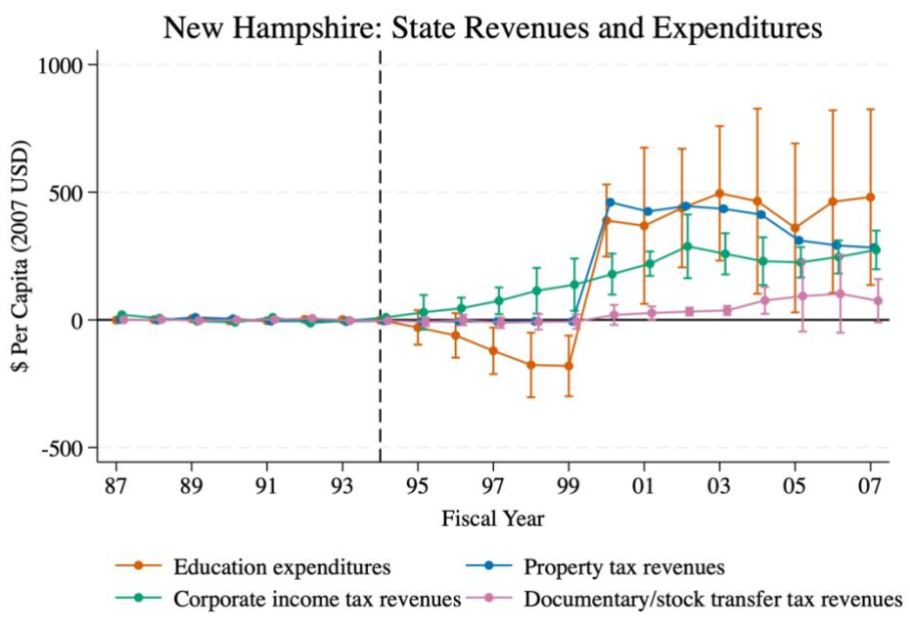
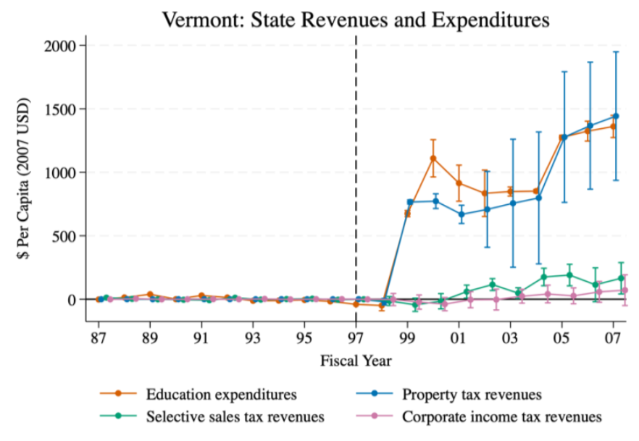
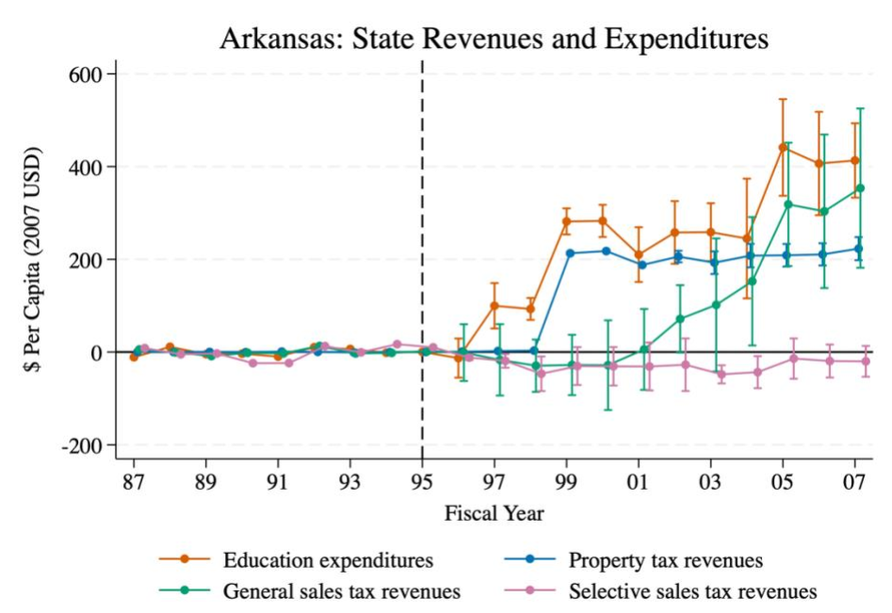
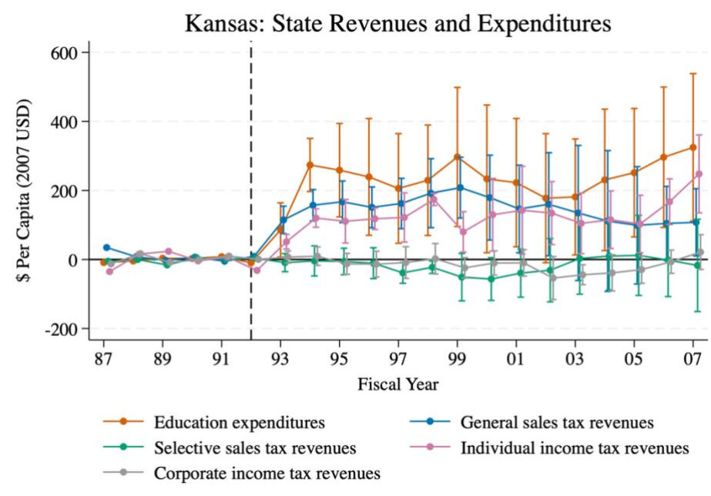
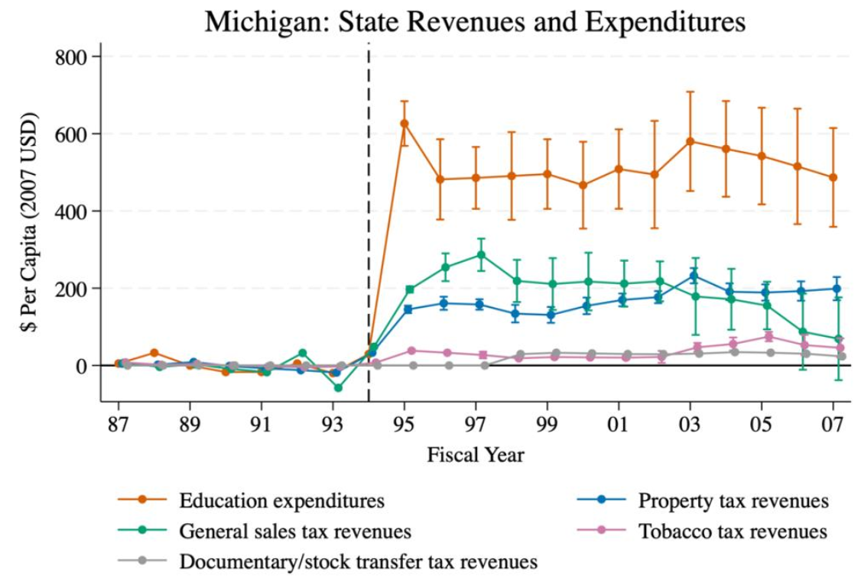
State property tax revenues
Sales tax revenues
Income tax revenues

Slide 45
Q&A and Discussion with Panel on Next Steps for Delaware

