Slide 2
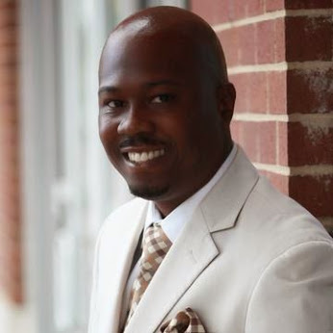
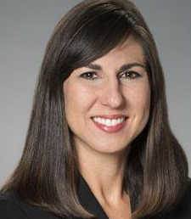
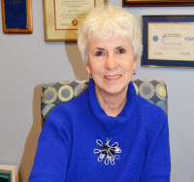
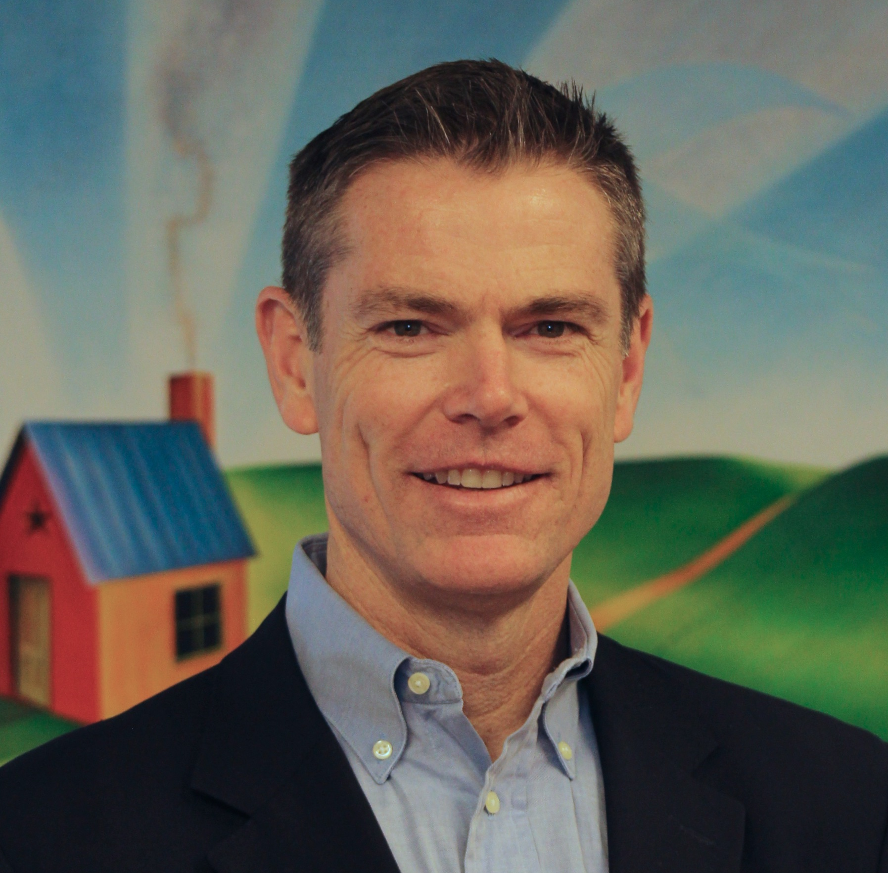
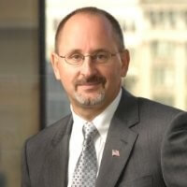
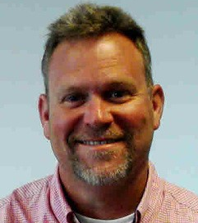
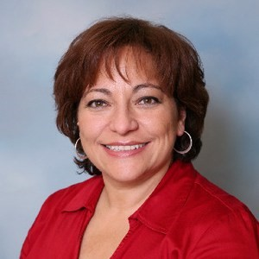
Leadership Team Members
Jeffrey T. Benson, Jr.
President - One Direction Insurance - Benson Development Group, LLC
Justina M. Sapna
Vice President for Academic Affairs at Delaware Technical Community College
Ernest J. Dianastasis
CEO, The Precisionists, Inc.
Susan Bunting
Delaware Secretary of Education
Paul A. Herdman
President and CEO, Rodel Foundation of Delaware
Gary Stockbridge
President, Delmarva Power
Heath Chasanov
Superintendent, Woodbridge School District
Mark Holodick
Superintendent, Brandywine School District
Margie López Waite
Head of School at Las Américas ASPIRA Academy

Slide 3
[Video Plays]

Slide 4
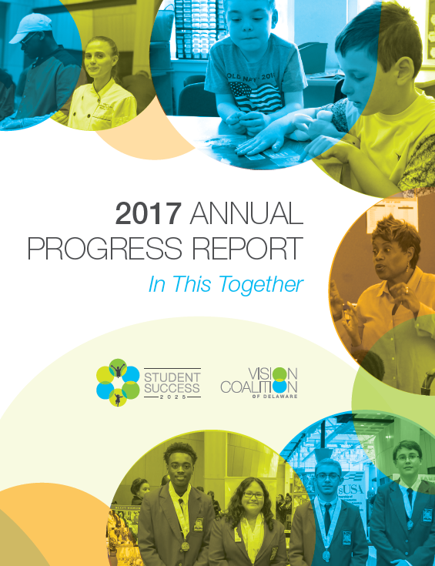
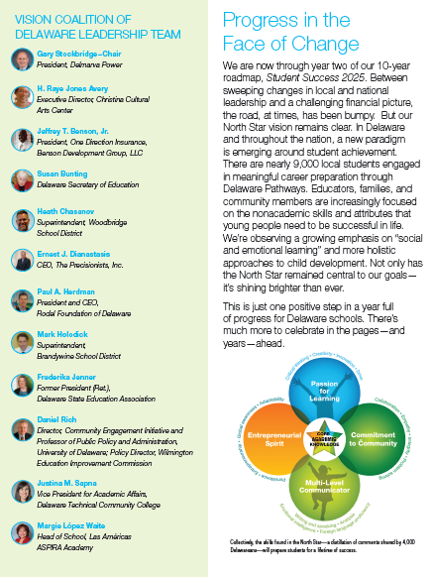
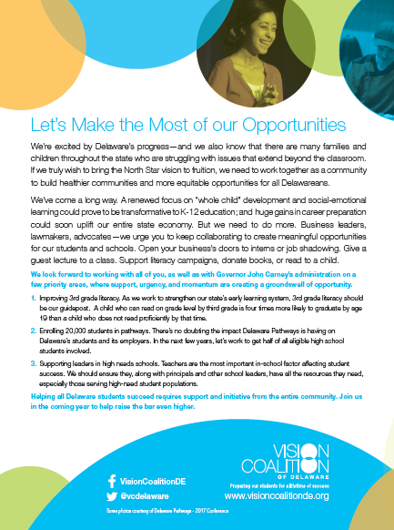

Slide 5
We’ve been able to maintain and expand initiatives including:
College access programs
Principal training programs
Readiness Teams
Developmental screenings
Language immersion

Slide 6
And, we have been building some important systems to support the work including:
The State’s ESSA plan and its implementation
Work-based learning intermediary at Del Tech
Trauma-informed training capacity

Slide 7
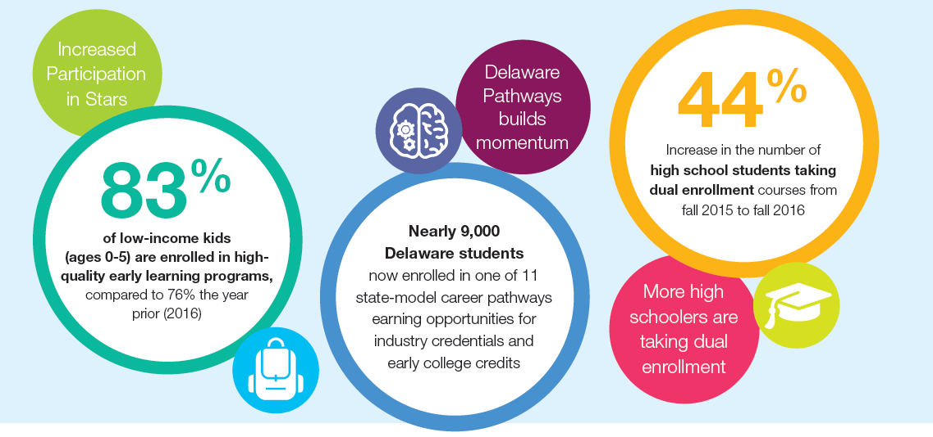
Areas of Progress

Slide 8
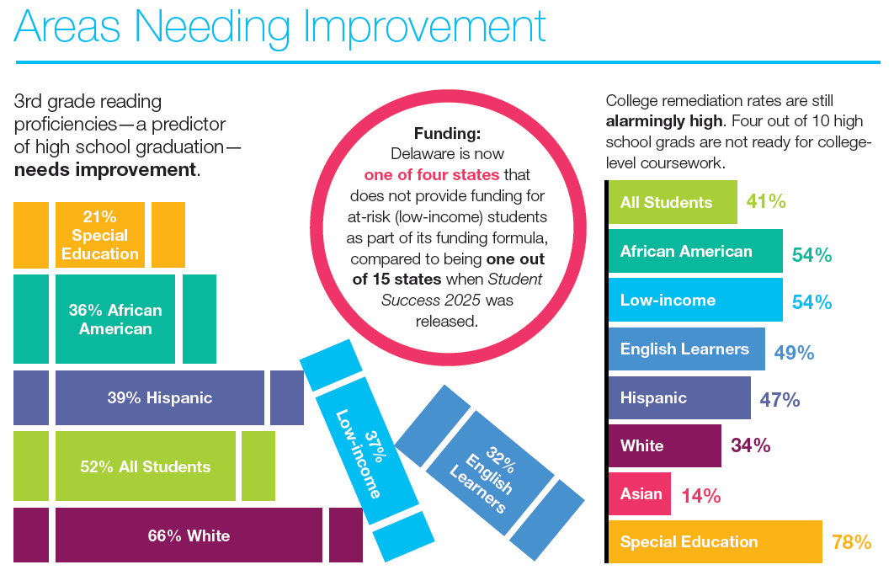

Slide 9
Our Major Priorities
Strengthening early learning, with a focus on 3rd grade literacy
Continuing to expand pathways and invest in college and career supports
Supporting leaders—including educators—in high-needs schools

Slide 10
Get Involved
We urge all of you to continue collaborating across sectors and industries
Host interns
Give a guest lecture to a class
Let students come do some job shadowing.
Support literacy campaigns
Read to a child
For more ideas? Visit www.visioncoalitionde.org.

